Slide 1
INITIATION WORKSHOP

Slide 2
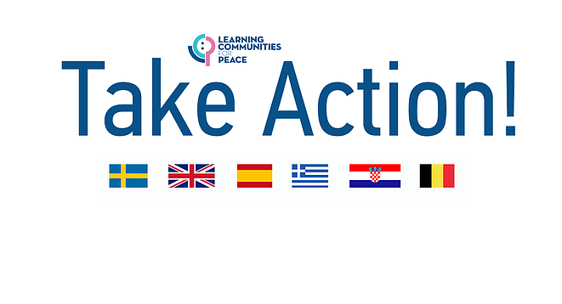

Slide 3
Identify, develop, test and evaluate
Learning Communities for Peace strategies steered by 5 primary
schools in Croatia, Greece, Sweden and the UK. Support primary schools to build their own unique peacebuilding
strategy and become hubs for peace within their community.

Slide 4
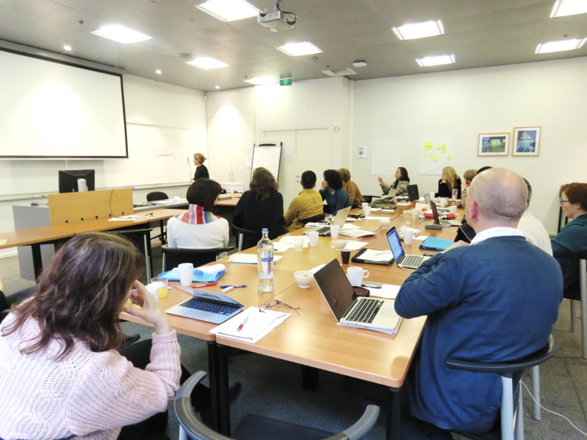
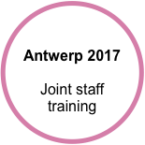

Slide 5
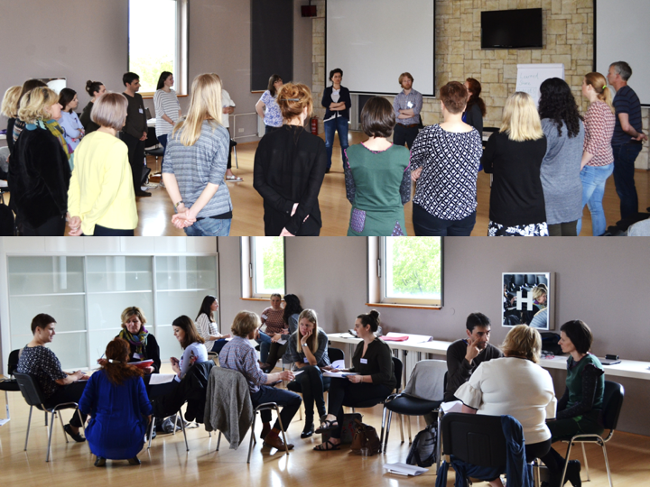
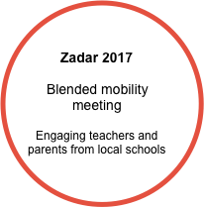

Slide 6
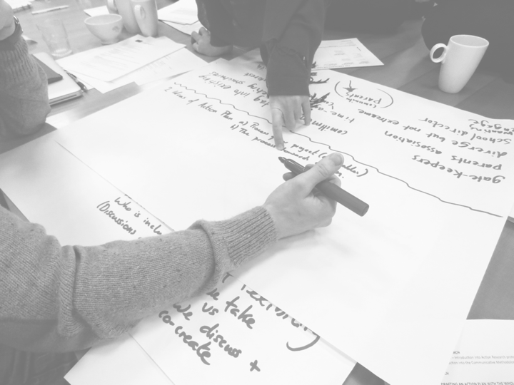
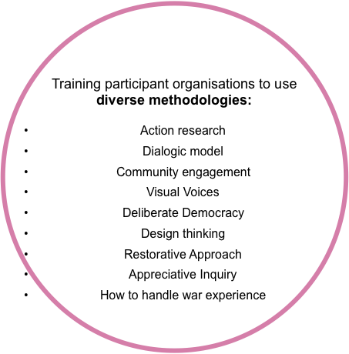
Training participants to use and adapt diverse methodologies such as:
Action research
Dialogic model
Community engagement
Visual Voices
Deliberate Democracy
Design thinking
Restorative Approach
Appreciative Inquiry
How to handle war experience

Slide 7
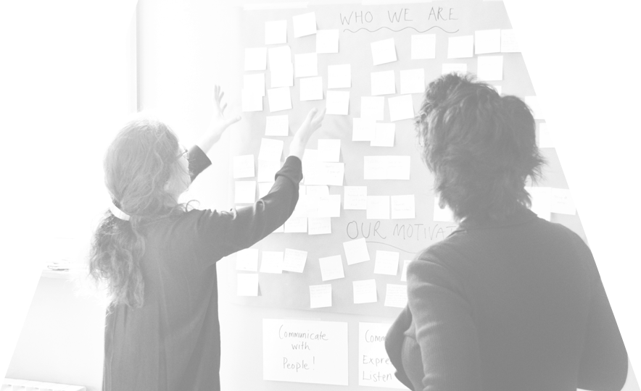
Every LCP develops their own unique peacebuilding strategy
Egalitarian and sustainable dialogues between all the stakeholders
Co-design the process to create and share ownership
The process is KEY!
Action Research
= studying your own practice

Slide 8
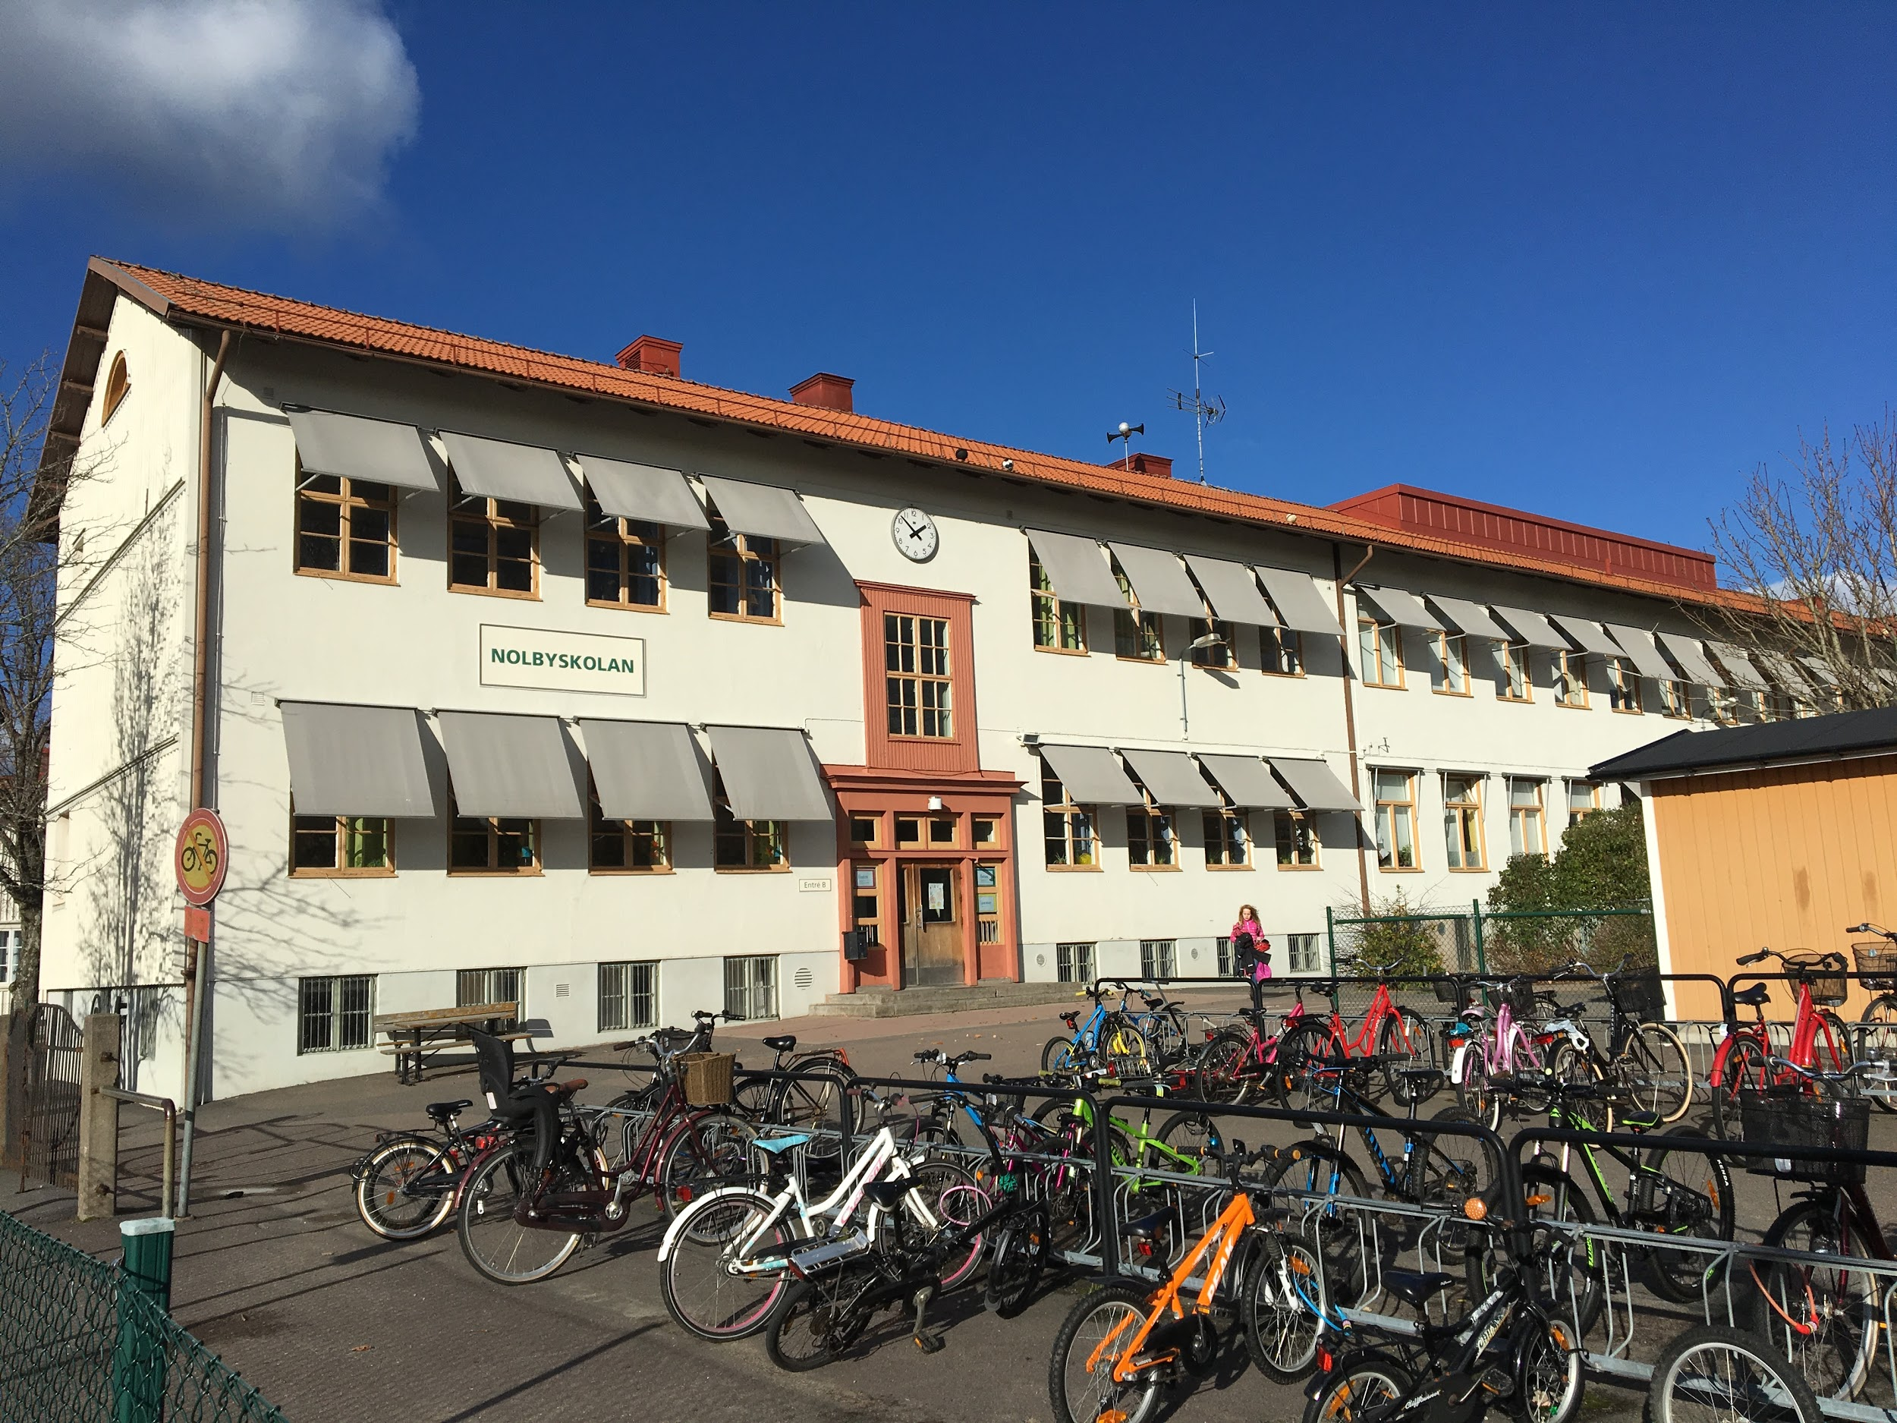
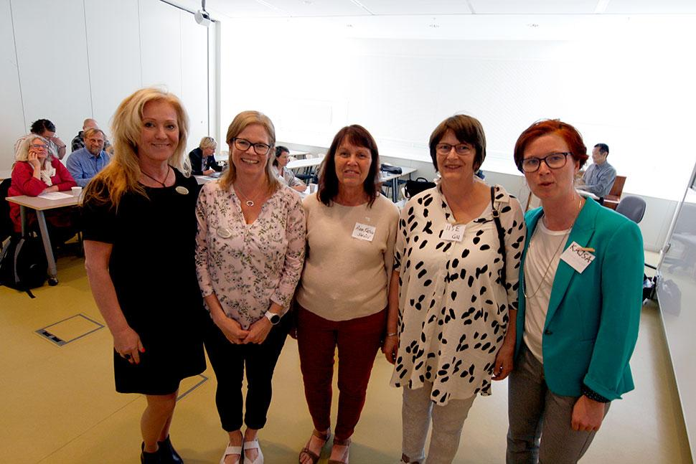
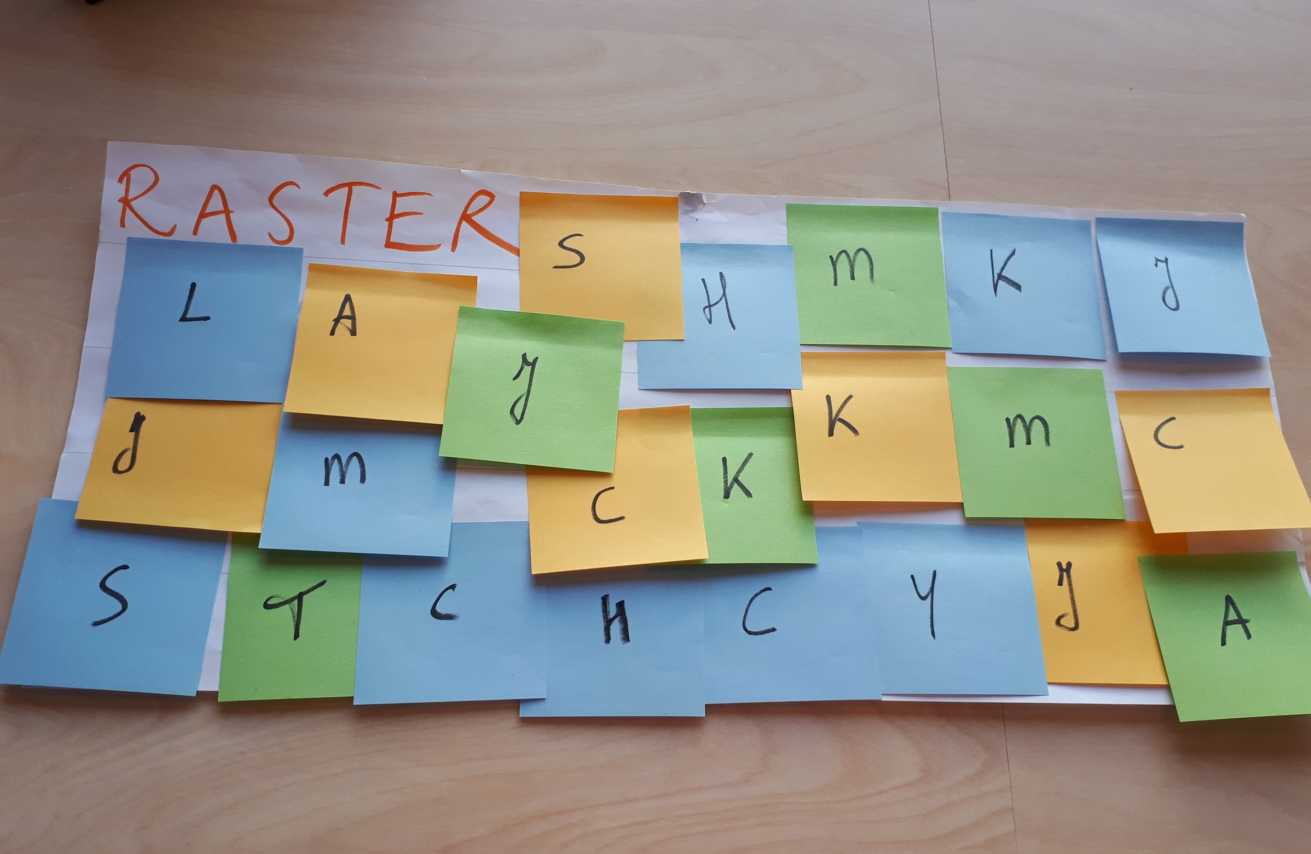
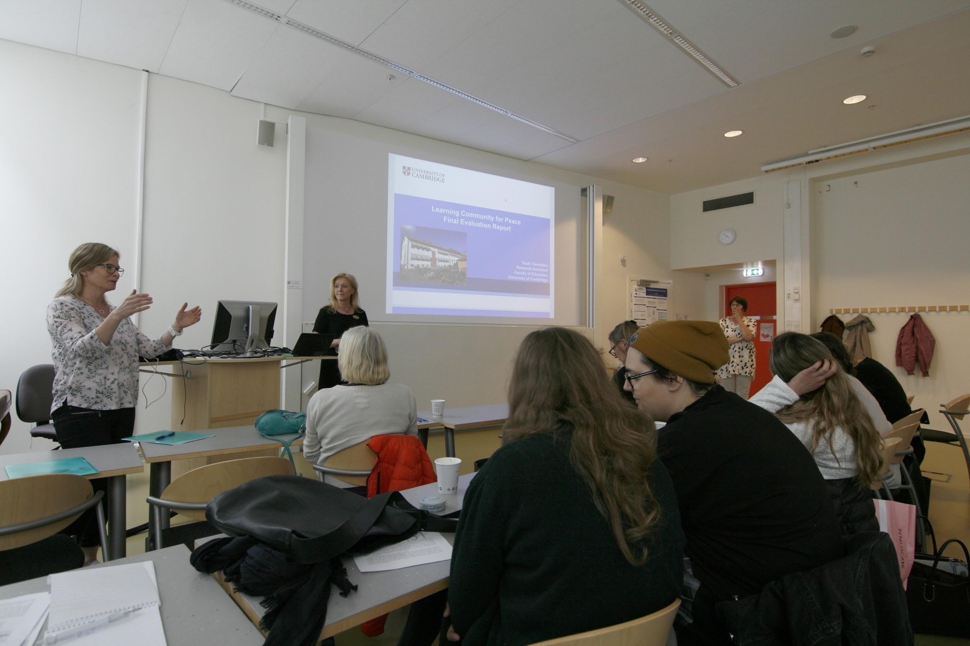
the case of
SWEDEN

Slide 9
What is your name?
Which is your school or community?
Which emoji represents your mood today?
What motivates you to be here today?

Slide 10
What dreams
do you have for your society
and/or school community?

Slide 11
What is your name?
Which is your school or community?
Which emoji represents your mood today?
What motivates you to be here today?

Slide 12
For us, building a Learning Community for Peace means
_________________________
_________________________
_________________________
_________________________

Slide 13
Video 2

Slide 14
LCP partners & schools

Slide 15
Thank you!

